Slide 1
Black-body Radiation

Slide 2
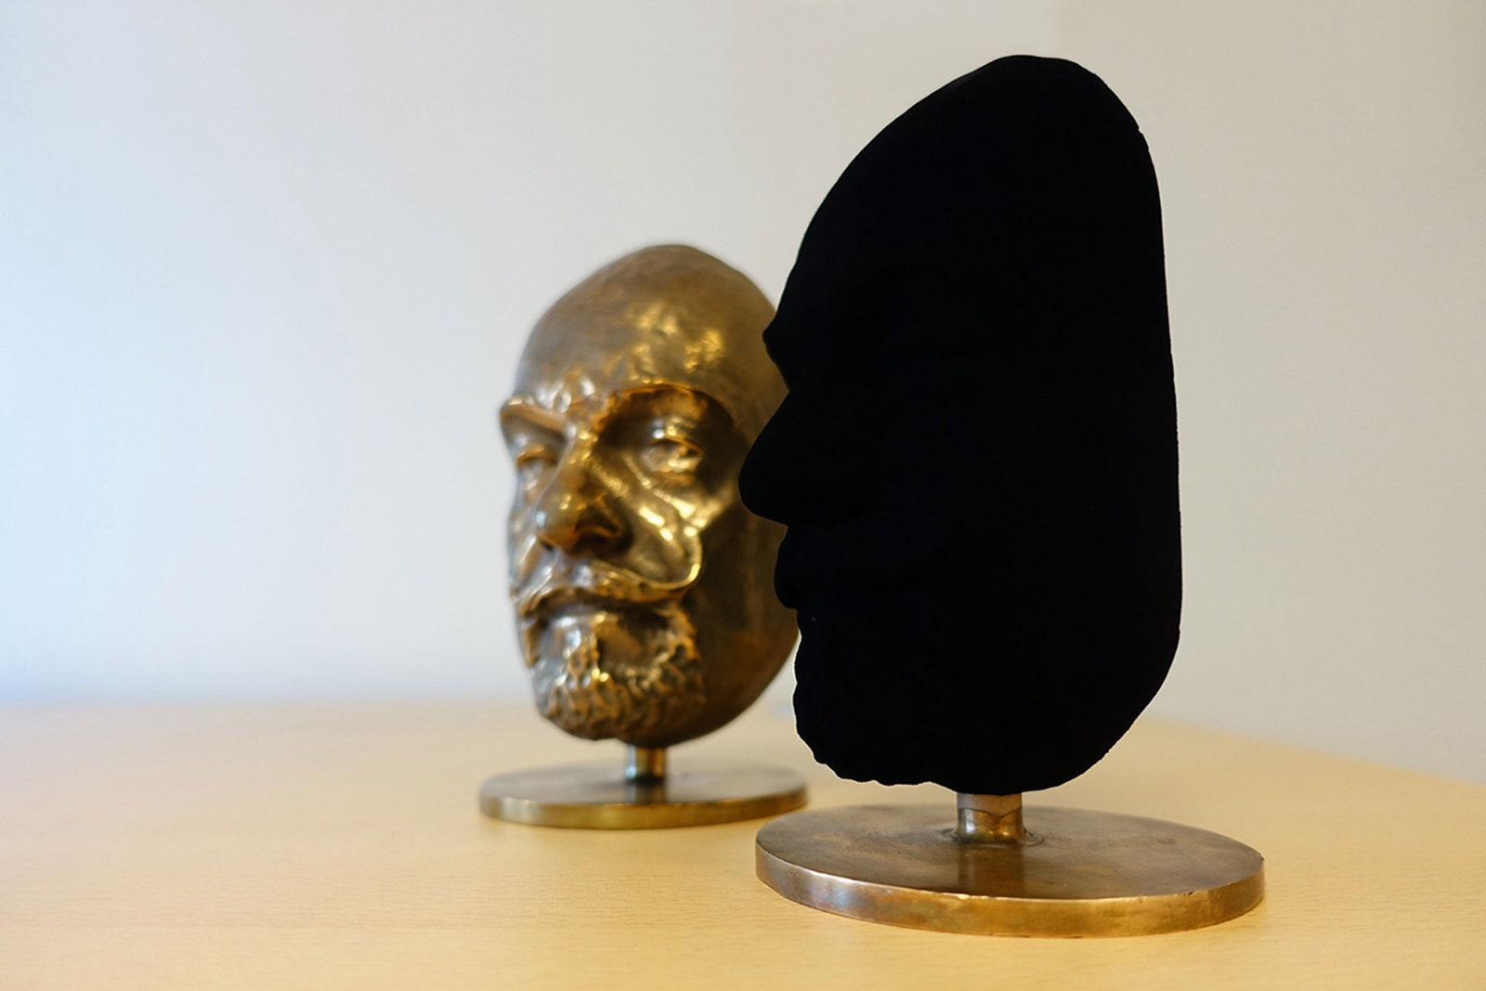
Black-body Radiation
If you can see an object, it is because it is reflecting light into your eyes.
If that object appears to be a certain colour, it is because it is reflecting light of specific wavelengths into your eyes – the others are being absorbed.
A black body (sometimes blackbody) is an object that absorbs all light, regardless of its wavelength.
Black bodies are idealised objects – they don’t actually exist – but stars, black holes, and synthetic materials such as Vantablack get close.
However, black bodies (like every other object, even in the dark) still emit light.
Notes:
Vantablack absorbs 99.965% of visible light!

Slide 3
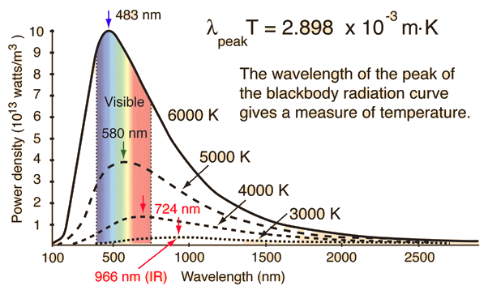
Black-body Radiation
All objects are constantly emitting light due to the thermal motion of their particles (almost exclusively their electrons).
At low temperatures, this light is very faint and almost exclusively infrared.
As an object’s temperature increases, the intensity (brightness) of this thermal radiation – the area under the curve – increases with it. However, its ‘colour’ begins to change as well.
The peak wavelength moves into the visible spectrum, causing objects to become ‘red hot’ (as they emit visible light mainly from the red end of the spectrum) and eventually ‘white hot’ (as they emit light from across the visible spectrum).
Notes:
This also explains why eye protection is so important when welding – the amount of UV becomes dangerous to your eyes.

Slide 4
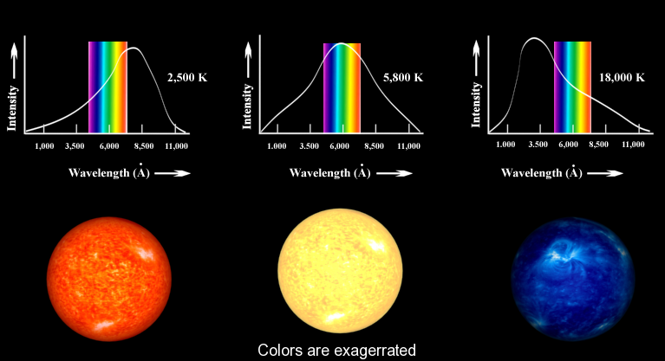
Black-body Radiation
When this radiation is emitted by a black body, it is known as black-body radiation.
Most thermal radiation emitted by real objects can be approximated as black-body radiation, allowing us to estimate the temperatures of distant stars and planets.

Slide 5
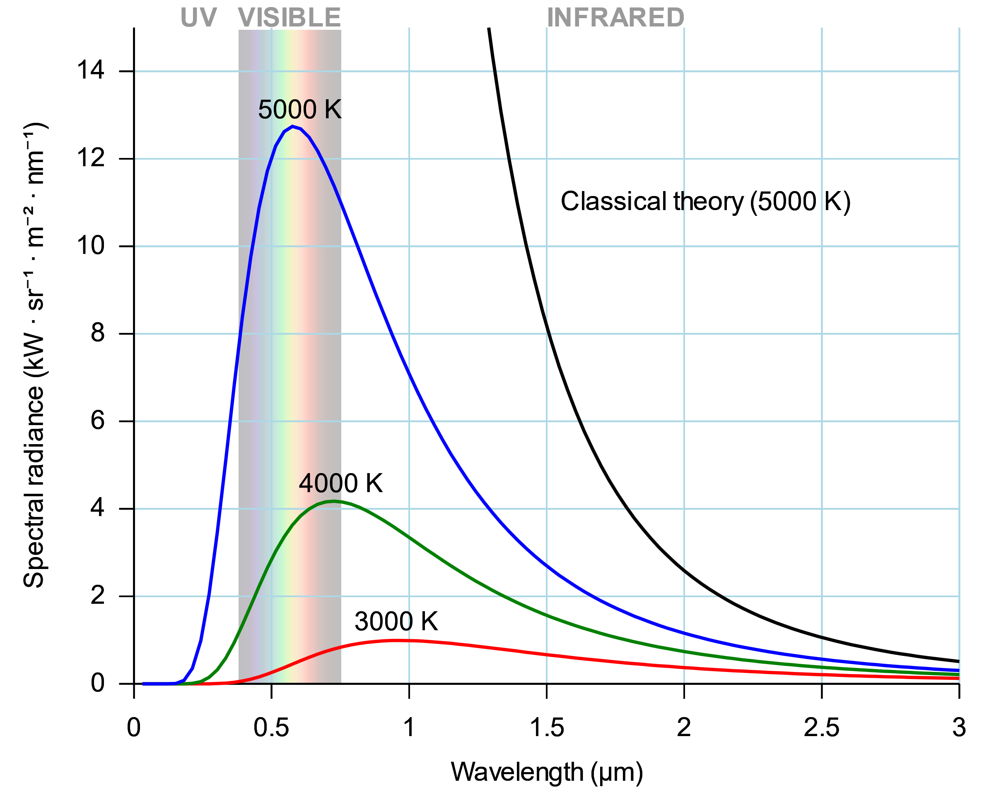
The Ultraviolet Catastrophe
The dominant classical theory at the time, the Rayleigh-Jeans model, predicted this phenomenon well at large wavelengths but very poorly at small ones such as the UV spectrum.
This spectacular failure of classical physics, commonly referred to as the ultraviolet catastrophe, marked the beginning of what would later become quantum physics.

Slide 6

Notes:
Another good explanation: https://youtu.be/7BXvc9W97iU

